Slide 1


Takagi-Sugeno Fuzzy Systems
Presentation By: Mojtaba Nourani
Month 2020

Slide 2
Outline
Takagi-Sugeno systems as interpolators between memoryless functions
Takagi-Sugeno systems as interpolators between linear state-space dynamic systems
Parallel Distributed Compensation
Application to control engineering
System Identification in TSK form from data

Slide 3

Takagi-Sugeno systems as interpolators between memoryless functions
Consider a T – S fuzzy system with R rules of the form:
$If x_{1} is P_{1}^{k} and x_{2} is P_{2}^{L} and…and x_{n} is P_{n}^{M}, then q^{i}=f_{i}(.)$
Using the same operators as Mamdani inference method and by substituting the TSK consequents we have:
$$y^{crisp}=\frac{\sum_{i=1}^{R}{q^{i}μ_{i}(x)}}{\sum_{i=1}^{R}{μ_{i}(x)}}$$
Here we assume $f_{i}\left(.\right)=a_{0}^{i}+a_{1}^{i}x_{1}+a_{2}^{i}x_{2}+…+a_{n}^{i}x_{n}$
[1]: Lilly, J.H., 2011. Fuzzy control and identification. John Wiley & Sons.

Slide 4


Takagi-Sugeno systems as interpolators between linear state-space dynamic systems
Equivalently: $y^{crisp}=q^{1}ξ_{1}\left(t\right)+q^{2}ξ_{2}\left(t\right)+…+q^{R}ξ_{R}(t)$
Where $ξ_{i}\left(t\right)=\frac{μ_{i}(x(t))}{\sum_{j=1}^{R}{μ_{j}(x(t))}}$
Fuzzy basis functions
What if the rules have the following form?
$If x_{1} is P_{1}^{k} and x_{2} is P_{2}^{L} and…and x_{n} is P_{n}^{M}, then {\dot{x}}^{i}=A_{i}x\left(t\right)+b_{i}u(t)$
By substituting the new consequents we have:
$$\dot{x}(t)=\frac{\sum_{i=1}^{R}{μ_{i}(x(t))(A_{i}x\left(t\right)+b_{i}u(t))}}{\sum_{i=1}^{R}{μ_{i}(x(t))}}$$

Slide 5

Takagi-Sugeno systems as interpolators between linear state-space dynamic systems
Here, $A\left(t\right)=ξ_{1}\left(t\right)A_{1}+ξ_{2}\left(t\right)A_{2}+…+ξ_{R}\left(t\right)A_{R}$ & $b\left(t\right)=ξ_{1}\left(t\right)A_{1}+ξ_{2}\left(t\right)A_{2}+…+ξ_{R}\left(t\right)A_{R}$
Example: Consider a two-input fuzzy system with rules
$If x_{1} is P_{1}^{1} and x_{2} is P_{2}^{1}, then {\dot{x}}^{1}=A_{1}x\left(t\right)+b_{1}u(t)$
$If x_{1} is P_{1}^{1} and x_{2} is P_{2}^{2}, then {\dot{x}}^{2}=A_{2}x\left(t\right)+b_{2}u(t)$
$If x_{1} is P_{1}^{2} and x_{2} is P_{2}^{1}, then {\dot{x}}^{3}=A_{3}x\left(t\right)+b_{3}u(t)$
$If x_{1} is P_{1}^{2} and x_{2} is P_{2}^{2}, then {\dot{x}}^{4}=A_{4}x\left(t\right)+b_{4}u(t)$
Where $A_{1}=\left[\begin{matrix}0 & 1 \\ −2 & −2\end{matrix}\right],A_{2}=\left[\begin{matrix}0 & 1 \\ −1 & −2\end{matrix}\right]$, $A_{3}=\left[\begin{matrix}0 & 1 \\ −3 & −2\end{matrix}\right]$, $A_{4}=\left[\begin{matrix}1 & 1 \\ −2 & −2\end{matrix}\right]$
And $b_{1}=\left[\begin{matrix}0 \\ 2\end{matrix}\right],b_{2}=\left[\begin{matrix}2 \\ 2\end{matrix}\right]$, $b_{3}=\left[\begin{matrix}−2 \\ 2\end{matrix}\right]$, $b_{4}=\left[\begin{matrix}0 \\ −2\end{matrix}\right]$
[1]: Lilly, J.H., 2011. Fuzzy control and identification. John Wiley & Sons.

Slide 6
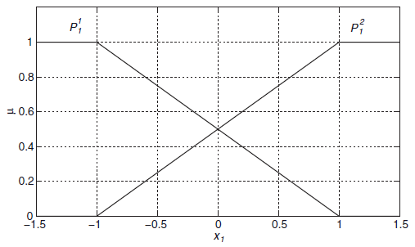
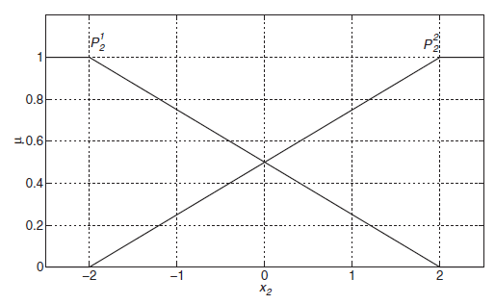
Takagi-Sugeno systems as interpolators between linear state-space dynamic systems
Assume membership functions as follows
[1]: Lilly, J.H., 2011. Fuzzy control and identification. John Wiley & Sons.

Slide 7

Takagi-Sugeno systems as interpolators between linear state-space dynamic systems
Suppose a particular time when $x_{1}\left(t_{1}\right)=0.4 \& x_{2}\left(t_{1}\right)=−0.8$
Then $μ_{1}\left(t_{1}\right)=0.21, μ_{2}\left(t_{1}\right)=0.09, μ_{3}\left(t_{1}\right)=0.49, μ_{4}\left(t_{1}\right)=0.21$
And $ξ_{1}\left(t\right)=μ_{1}\left(t_{1}\right)$, $ξ_{2}\left(t\right)=μ_{2}\left(t_{1}\right)$, $ξ_{3}\left(t\right)=μ_{3}\left(t_{1}\right)$, $ξ_{4}\left(t\right)=μ_{4}\left(t_{1}\right)$
So, at $t_{1}$:
$A\left(t_{1}\right)=ξ_{1}\left(t_{1}\right)A_{1}+ξ_{2}\left(t_{1}\right)A_{2}+…+ξ_{4}\left(t_{1}\right)A_{4}$ =$\left[\begin{matrix}0.21 & 1 \\ −2.4 & −2\end{matrix}\right]$
$b\left(t_{1}\right)=ξ_{1}\left(t_{1}\right)b_{1}+ξ_{2}\left(t_{1}\right)b_{2}+…+ξ_{4}\left(t_{1}\right)b_{4}$ =$\left[\begin{matrix}−0.8 \\ 1.16\end{matrix}\right]$
And the final system becomes:
$$\left[\begin{matrix}\dot{x_{1}} \\ {\dot{x}}_{2}\end{matrix}\right]=\left[\begin{matrix}0.21 & 1 \\ −2.4 & −2\end{matrix}\right]\left[\begin{matrix}x_{1} \\ x_{2}\end{matrix}\right]+\left[\begin{matrix}−0.8 \\ 1.16\end{matrix}\right]\left[\begin{matrix}u_{1} \\ u_{2}\end{matrix}\right]$$
[1]: Lilly, J.H., 2011. Fuzzy control and identification. John Wiley & Sons.

Slide 8
Coding the previous example

Slide 9

Parallel Distributed Scheme for controlling T-S fuzzy systems
Consider a plant with R rules of the form:
$$If x_{1} is P_{1}^{k} and x_{2} is P_{2}^{L} and…and x_{n} is P_{n}^{M}, then {\dot{x}}^{i}=A_{i}x\left(t\right)+b_{i}u\left(t\right)$$
The parallel distributed pole placement controller is another T-S system with R rules of the form:
$$If x_{1} is P_{1}^{k} and x_{2} is P_{2}^{L} and…and x_{n} is P_{n}^{M}, then u^{i}\left(t\right)=−k_{i}x\left(t\right)$$
Where the eigenvalues of $A_{i}−b_{i}k_{i}$ has to be in the left-half plane.
Lyapunov stability
Matlab LMI toolbox

Slide 10

System Identification in TSK form data
Recap: Batch least squares estimation
Consider an algebraic system: $y\left(j\right)=φ_{1}\left(j\right)θ_{1}+φ_{2}\left(j\right)θ_{2}+…+φ_{R}\left(j\right)θ_{R}$
Then the estimated parameters would be like ${\hat{θ}}^{∗}\left(k\right)={\left(φ^{T}φ\right)}^{−1}φ^{T}Y$
Assume we’re going to fit a T-S fuzzy system of the following form to the data:
$If x_{1} is A_{1}^{k} and x_{2} is A_{2}^{L} and…and x_{n} is A_{n}^{M}, then q^{i}(x)=a_{0}^{i}+a_{1}^{i}x_{1}+a_{2}^{i}x_{2}+…+a_{n}^{i}x_{n}$
The vector of unknown parameters to be identified are: $θ=$[$a_{0}^{i},{…,a}_{n}^{i}$], i=1:R
$$φ^{T}=[ξ_{1},ξ_{2},…,ξ_{R}, x_{1}ξ_{1}…{x_{1}ξ}_{R}, x_{n}ξ_{1}…{x_{n}ξ}_{R}]$$
$$f\left(x\right)=\frac{\sum_{i=1}^{R}{q^{i}μ_{i}\left(x\right)}}{\sum_{i=1}^{R}{μ_{i}\left(x\right)}}=φ^{T}θ$$

Slide 11
Coding an example

Slide 12
Fuzzy Multi-criteria Decision Making
Presentation By: Mojtaba Nourani
Month 2020

Slide 13
Outline
Analytic Hierarchy Process
Applications in daily life decision processes
Mathematical formulation of fuzzy analytic hierarchy processes
SuperDecision software
Coding
Future application

Slide 14
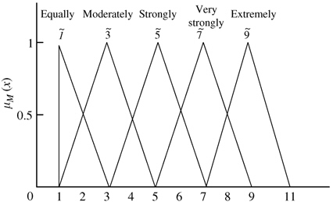
Pairwise Comparison Matrix
Attribute or criteria
(selecting a job)
Distance from home | wage | hours/week | Working environment | Working time
Scale of relative importance (Crisp)
1 | Equal importance
3 | Moderate importance
5 | Strong importance
7 | Very strong importance
9 | Extreme importance
Use MFs instead

Slide 15
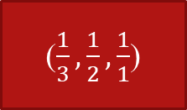
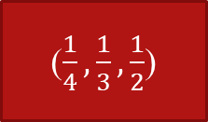
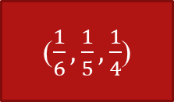
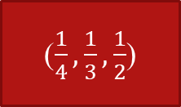
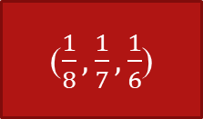
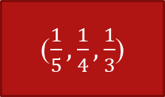
Example
Distance from home | wage | hours/week | Working environment
Distance from home
wage
hours/week
Working environment
(1,1,1)
(4,5,6)
(3,4,5)
(6,7,8)
($\frac{1}{6},\frac{1}{5},\frac{1}{4}$)
(1,1,1)
($\frac{1}{3},\frac{1}{2},\frac{1}{1}$)
(2,3,4)
($\frac{1}{5},\frac{1}{4},\frac{1}{3}$)
(1,2,3)
(1,1,1)
(2,3,4)
($\frac{1}{8},\frac{1}{7},\frac{1}{6}$)
($\frac{1}{4},\frac{1}{3},\frac{1}{2}$)
($\frac{1}{4},\frac{1}{3},\frac{1}{2}$)
(1,1,1)

Slide 16
Example
Distance from home | wage | hours/week | Working environment
Value for geometric mean
Distance from home
wage
hours/week
Working environment
(1,1,1)
(4,5,6)
(3,4,5)
(6,7,8)
(2.91,3.44,3.94)
($\frac{1}{6},\frac{1}{5},\frac{1}{4}$)
(1,1,1)
($\frac{1}{3},\frac{1}{2},\frac{1}{1}$)
(2,3,4)
(0.58,0.74,1)
($\frac{1}{5},\frac{1}{4},\frac{1}{3}$)
(1,2,3)
(1,1,1)
(2,3,4)
(0.80,1.11,1.41)
($\frac{1}{8},\frac{1}{7},\frac{1}{6}$)
($\frac{1}{4},\frac{1}{3},\frac{1}{2}$)
($\frac{1}{4},\frac{1}{3},\frac{1}{2}$)
(1,1,1)
(0.3,0.35,0.45)
Use geometric mean to calculate the weights

Slide 17
Example
Value for geometric mean
Fuzzy weights
Weights
(2.91,3.44,3.94)
(0.428, 0.610, 0.859)
0.633
Defuzzify
(0.58,0.74,1)
(0.085, 0.131, 0.218)
0.145
(0.80,1.11,1.41)
(0.117, 0.196, 0.309)
0.207
(0.3,0.35,0.45)
(0.044, 0.063, 0.099)
0.068

Slide 18
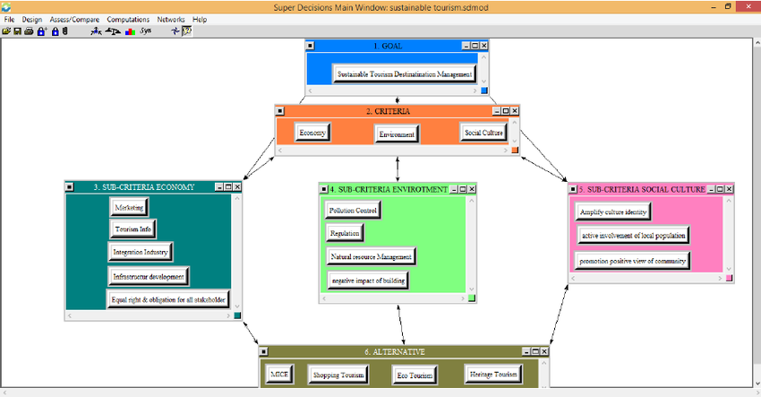
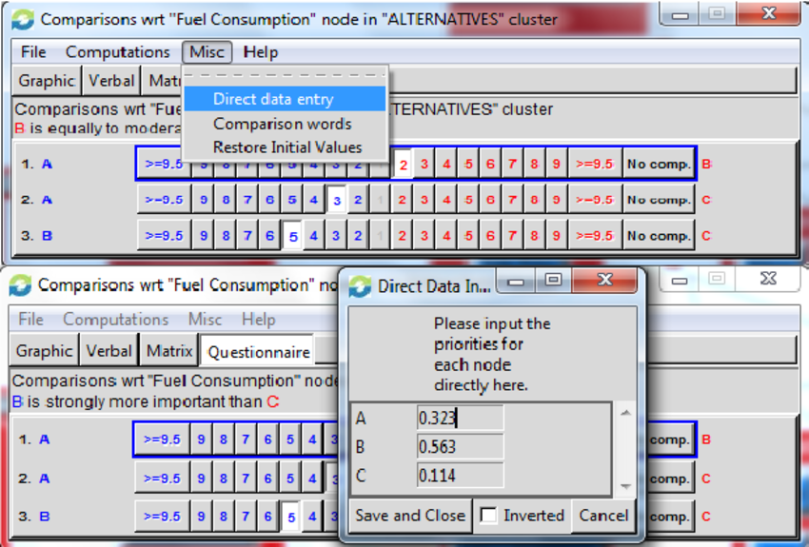
Super Decision Software and Coding a fuzzy AHP

Slide 19
Thank you for listening
I’ll be happy to answer your questions.
Brain-Storming!
You can also Email me at mojtaba.nourani@mail.um.ac.ir

